Slide 1
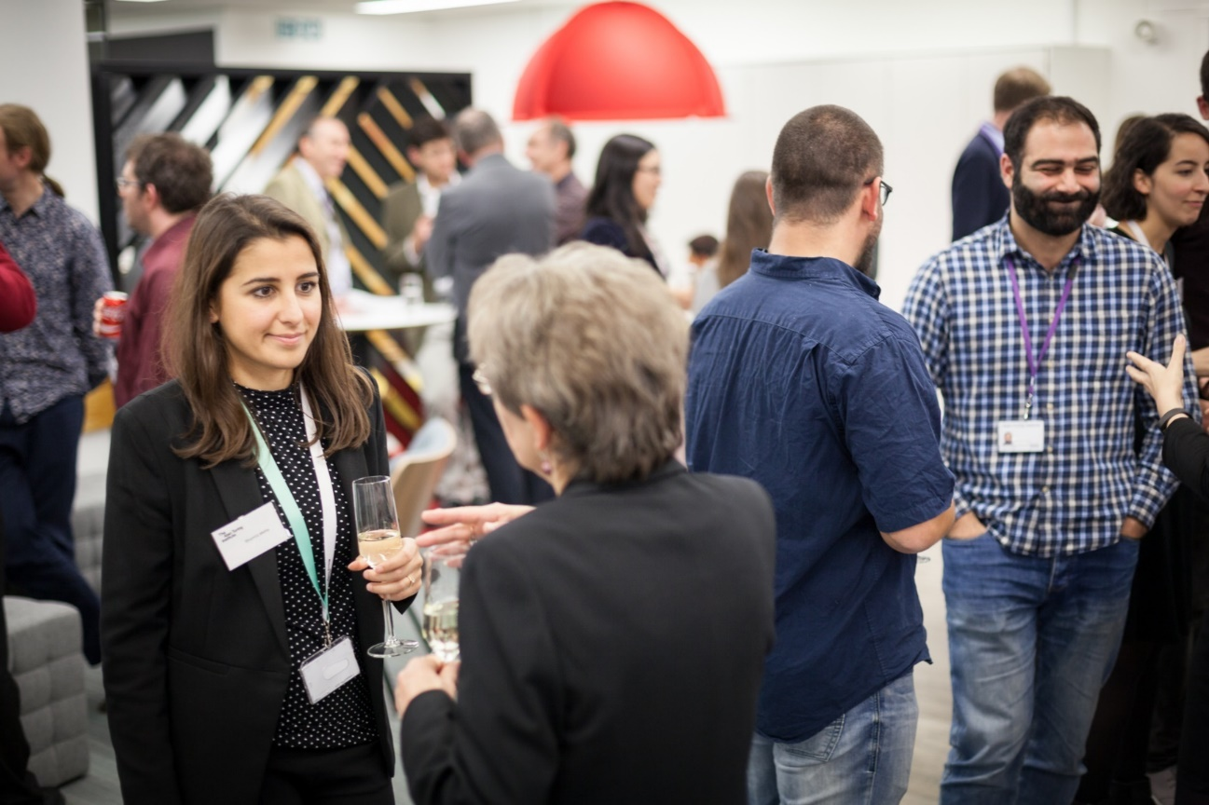
Geocomputation in a new era: modelling and analytics-driven planning Alan Wilson Chief Executive The Alan Turing Institute
Notes:
Main recommendations from the 3 month review undertaken by RK, NV & JA were:
Clear need for an interim strategy
Clearly authority and decision making
PC re-focused on research

Slide 2
1. Background
anchored in modelling
but look at the impacts of
‘big data’ (and especially new data)
computing power
additions from data science and AI
what does a ‘new era’ look like?
for modellers?
for young researchers?
the transformation of city planning?

Slide 3
2. Urban modelling: a quick recap
Migration
Trade
Employment
Jobs
Population
Transport
and telecoms
Economy
Use of services
Products or services
Infrastructure

Slide 4
good working models for e.g. transport and retail, much applied; pretty good comprehensive models – but under-applied
essentially comparative static, but the possibilities of making fully dynamic
then taking account of path dependence, phase changes etc means that we understand the limits of forecasting; but the bonus is that we can explore ‘critical points’; and future scenarios – and then chart paths towards the ‘good’ and away from the ‘bad’

Slide 5
3. ‘Big data’: data science perspectives
many new sources: mobile phone, sensors, ‘open’ admin data,…
a major ‘data wrangling’ challenge (with some modelling support – e.g. transport flows from mobile phone data
further (well-known but now more difficult) challenges of relating spatial, sectoral and time scales
implies a major challenge in information system design
and then head towards automation
NB the real-time element could lead us to real-time model calibration

Slide 6
3.1. Data science and AI
Data systems The ’big data’ revolution. The challenges of data wrangling and the design of systems’ architecture. Intelligently-searchable hierarchical information systems which are valuable in their own right. | Analytics We can bring an extensive analytics toolkit to bear: statistics, mathematical modelling, computer science, sometimes combined into machine learning. | Application domains The challenge is to combine our expertise in data systems and analytics with domain knowledge – often deep knowledge and theory in social science e.g. – to have real-world impact.

Slide 7
Data
Wrangling
Info System
Domain Knowledge
DATA
D.S Analytics
FEEDBACK
Plans
Indicators
Actions

Slide 8
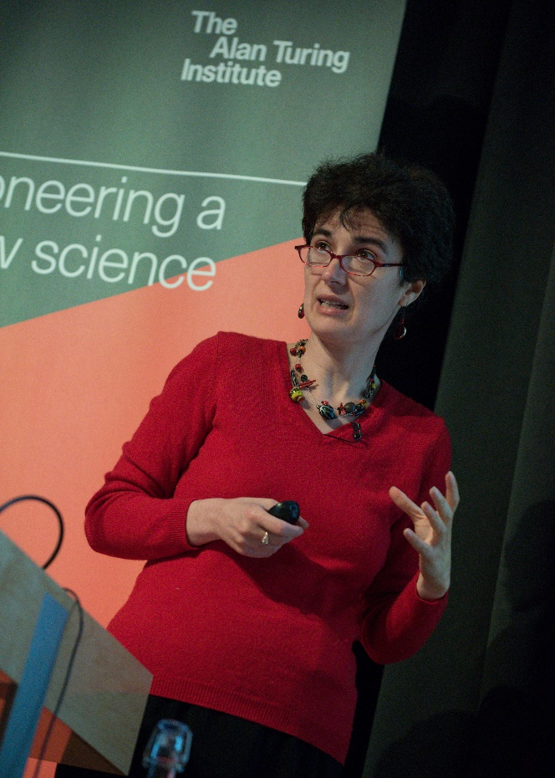
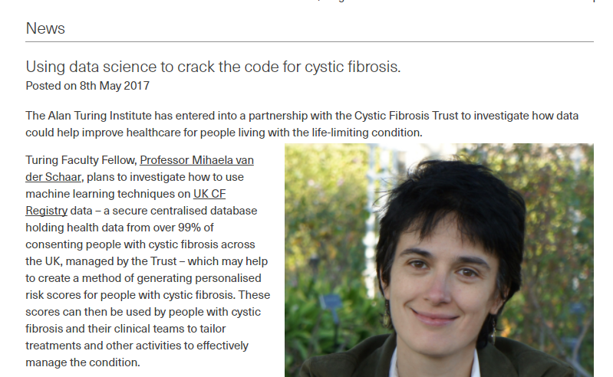
3.2. An example: revolutionising the health service (with a geo dimension)?
Notes:
The mission statement of the Alan Turing Institute describes my hope for my own work very well: "to make great leaps in data science research in order to change the world for the better."
Add conf papers
Better exposition slide Hidden states
Results

Slide 9
3.3. Additions from AI
ML applications:
real-time calibration through ML algorithms; ‘learning in real time?’
a new look at clustering?
a new look at statistics – e.g. propagation of uncertainty
dynamics’ insights in high-dimensional phase spaces; topological data analytics
incorporating prior learning
automation

Slide 10
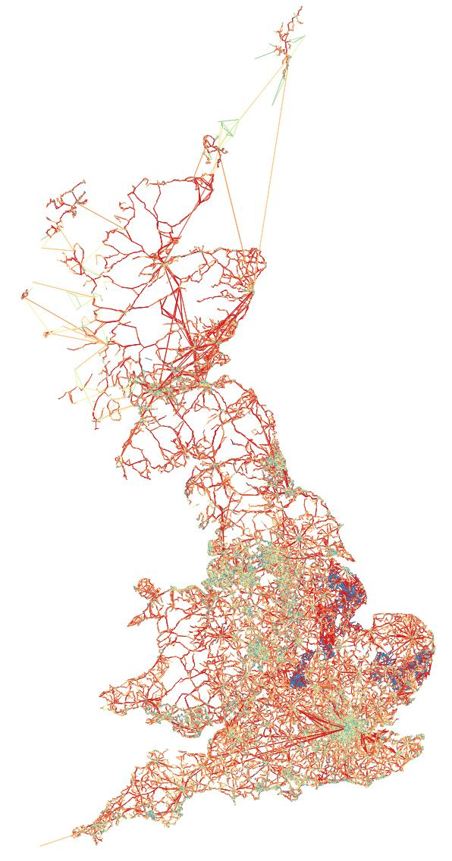
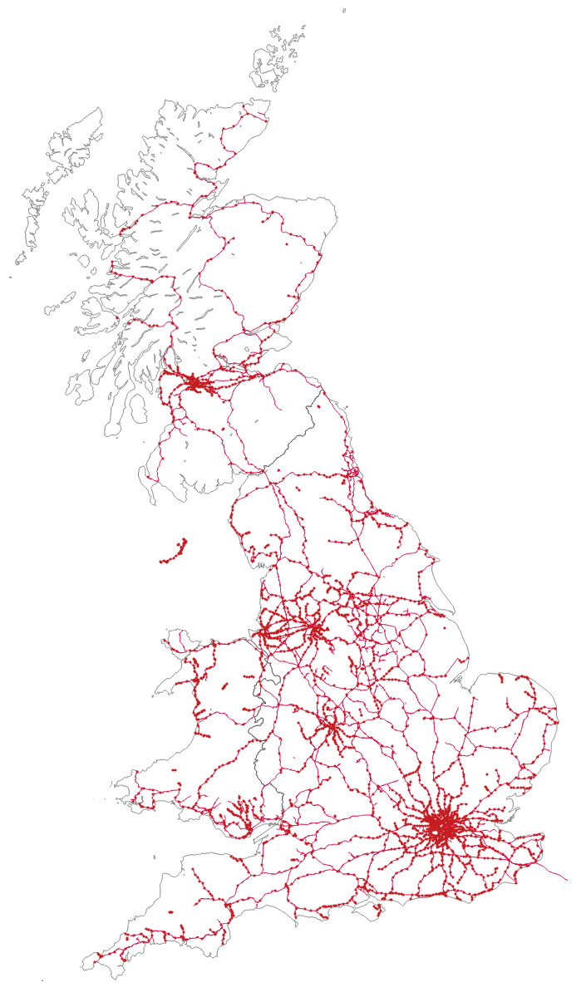
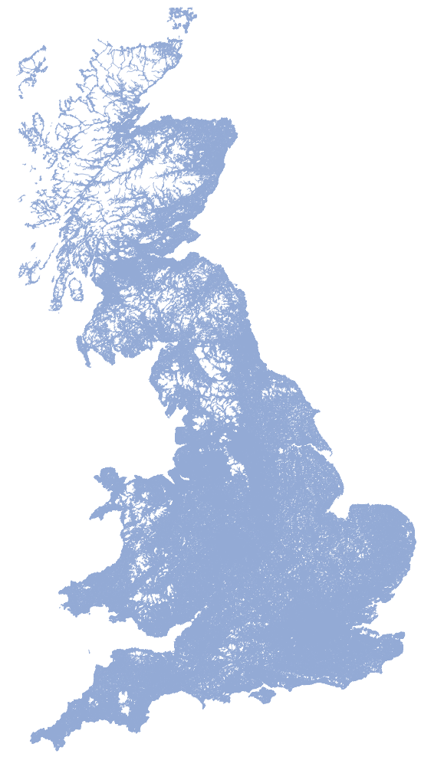
Modelling the UK: Quant
4. Computing power
Road, v=3.5M, e=8.4M
Bus, Ferry, v=0.29M, e=0.42M
Rail, v=3165, e=10,269

Slide 11
5. The new era-1: for modellers?
the ‘advice’ starts here!!
information system architecture
extending the range: new domain applications – health, education, defence etc
model types – add ABM etc
dynamics: beyond PoC: successful ‘development’; critical points
additions from AI (as noted)
real-time calibration: interaction parameters from structure?
clustering, communities
high-dimensional phase spaces
examples follow

Slide 12
more on the ‘advice’ dimension
much of what follows involves one or more of
new domains, possibly with poor data
‘large’ projects which remain ambitious: the general model
difficulty: adding depth and applications to dynamic modelling; beyond ‘proof of concept’ – ambitious in a different sense
be nervous of ‘following fashion’

Slide 13
5.1. Information system architecture
Static data
(geometry, census etc.)
Information
System
Input: outputs from different datasets
Scenarios and plans
Outputs: platform data base; some reports
The science: models and analysis:
outputs and planning indicators
Dynamic real time data
Console
Planning Knowledge
(densities, health, education, heritage etc. )
Scenarios and Plans
Reports from C.E.
Roumpani, Hudson-Smith and Wilson, 2014

Slide 14
5.2. Extending the range: new subsystems, the truly comprehensive model?
new scales:
national, multi-national
global
health – e.g. adding the ‘geo’ to a Mihaela system
education?
defence and security – ‘digital twins’
truly comprehensive?

Slide 15
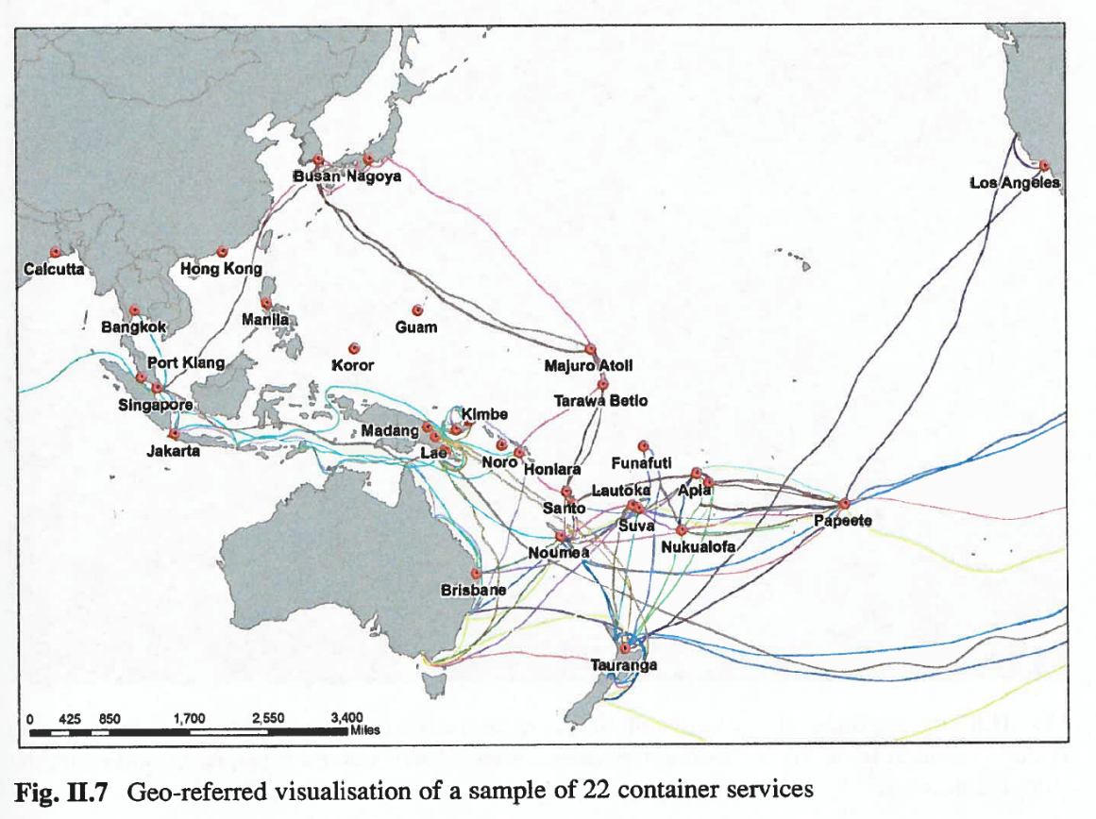
Example 1. A multi-national trade model: the South Pacific (container services) – Medda et Al (2017)

Slide 16
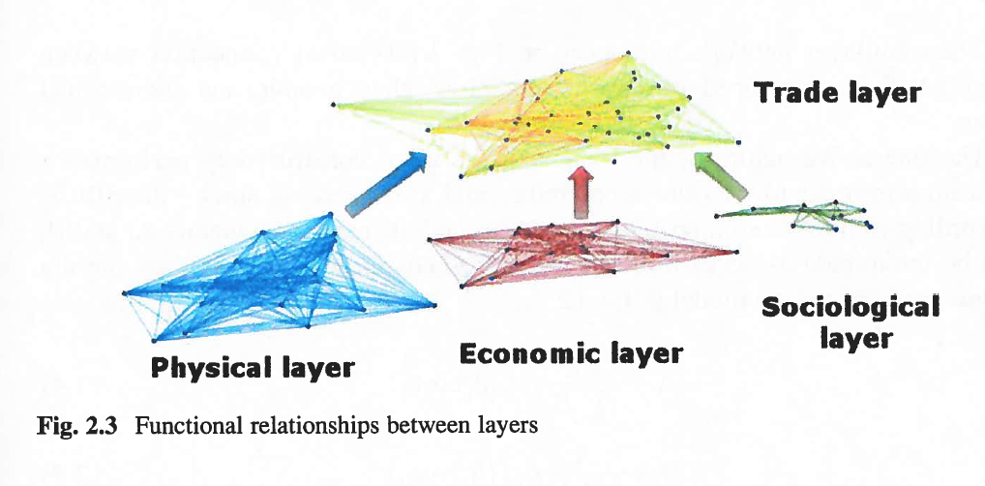
The multi-layer model

Slide 17
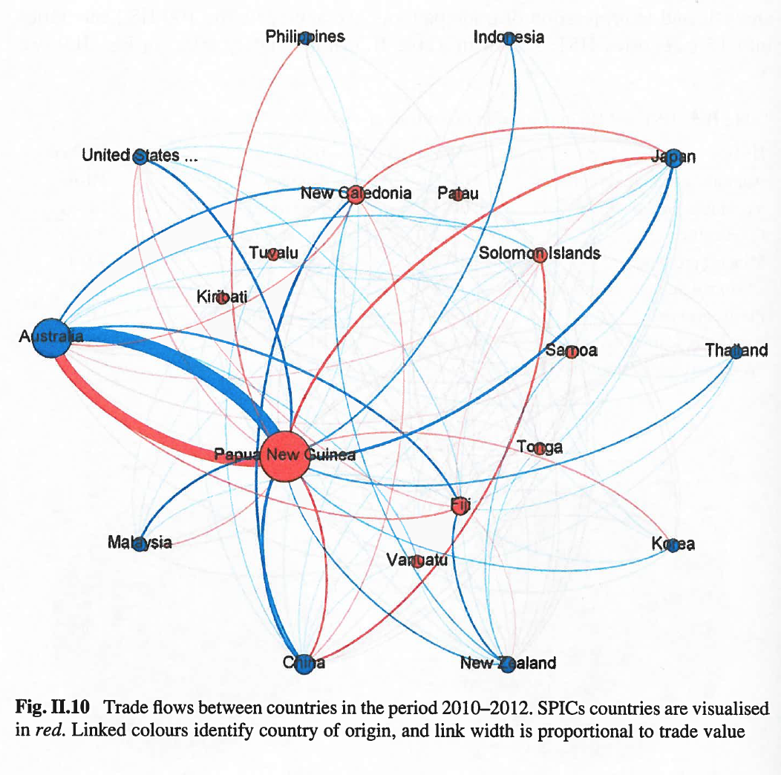
Principal SPIC trade flows

Slide 18
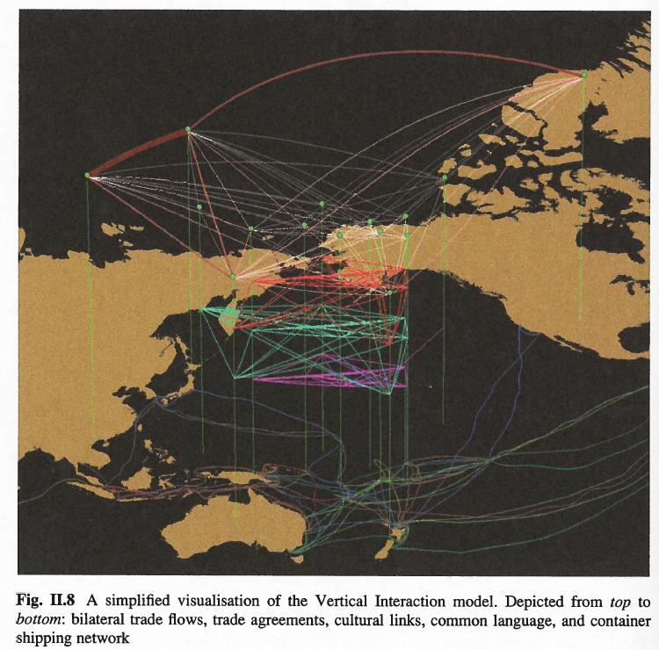
SPIC trade underpinned by layers

Slide 19
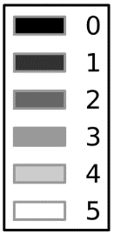
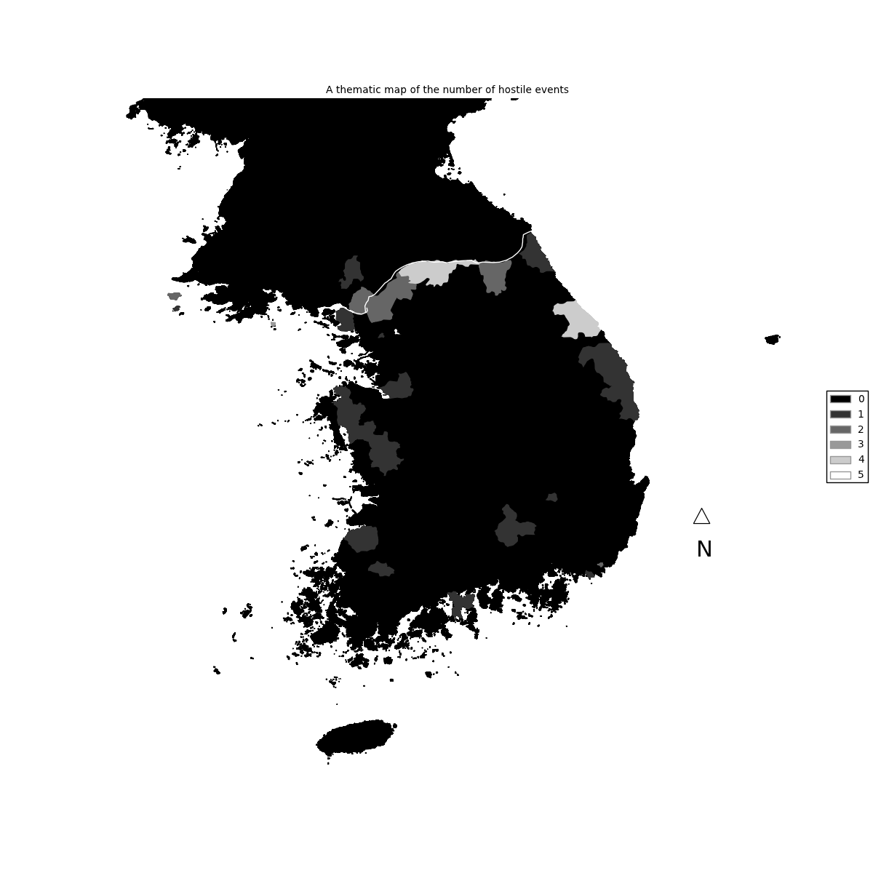
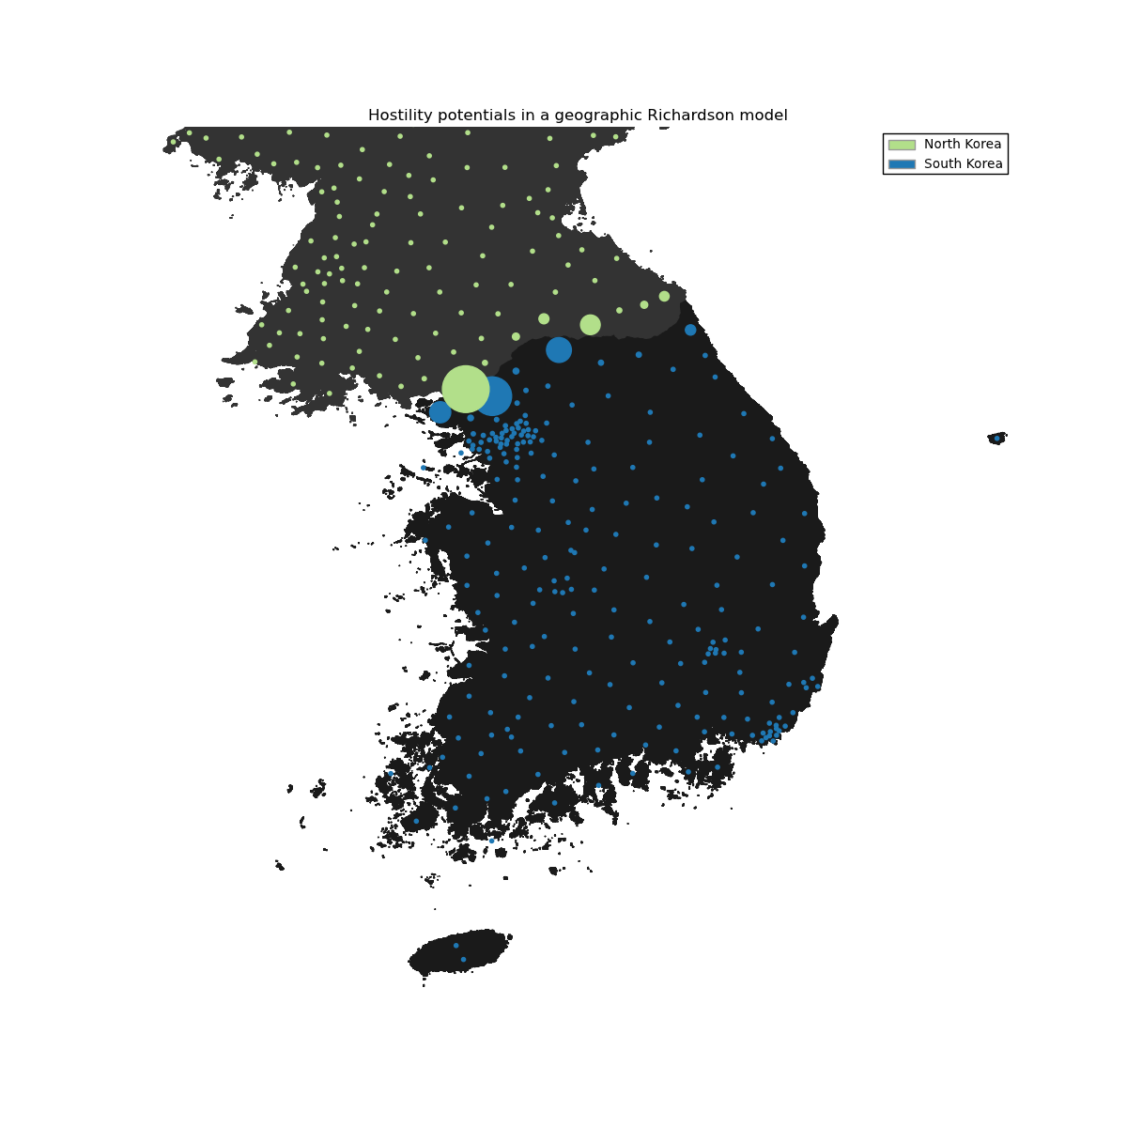

Example 2. Two-nation: Korean border disputes [Baudains et al, in Wilson (ed.) 2016]
Empirical data: Locations of North and South Korean disputes
Model data: Equilibrium values of model simulation

Slide 20
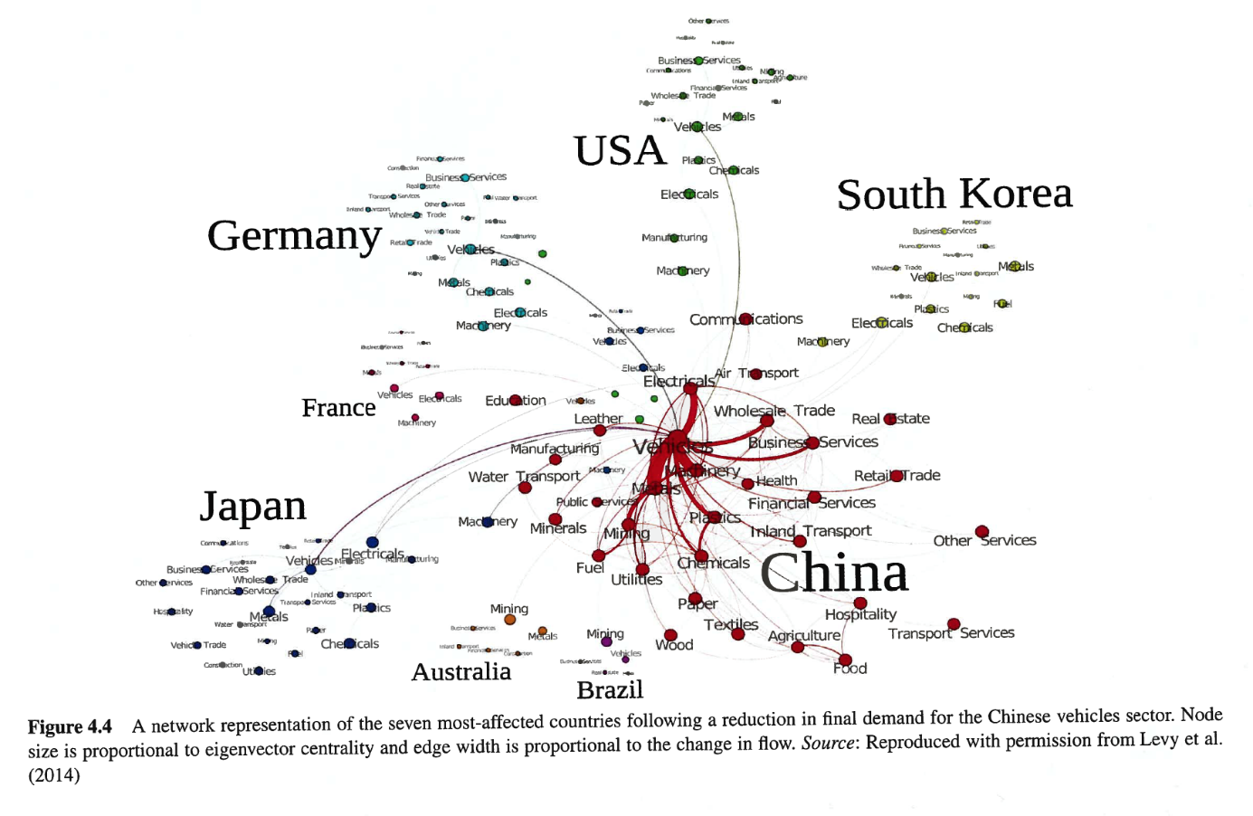
Example 3. Trade flows from the world model [Wilson (ed.), 2016]

Slide 21
Modelling the UK: Quant
Example 4. A national ‘urban’ model: NIC - towards a digital twin (Batty et al, 2013)
Road, v=3.5M, e=8.4M
Bus, Ferry, v=0.29M, e=0.42M
Rail, v=3165, e=10,269

Slide 22
5.3. Model types: combining through conditional probabilities
core
importance of ‘abstract mode’, generalised cost
for scenario development – see later
ABM – change of scale
gaming
network analysis
percolation

Slide 23
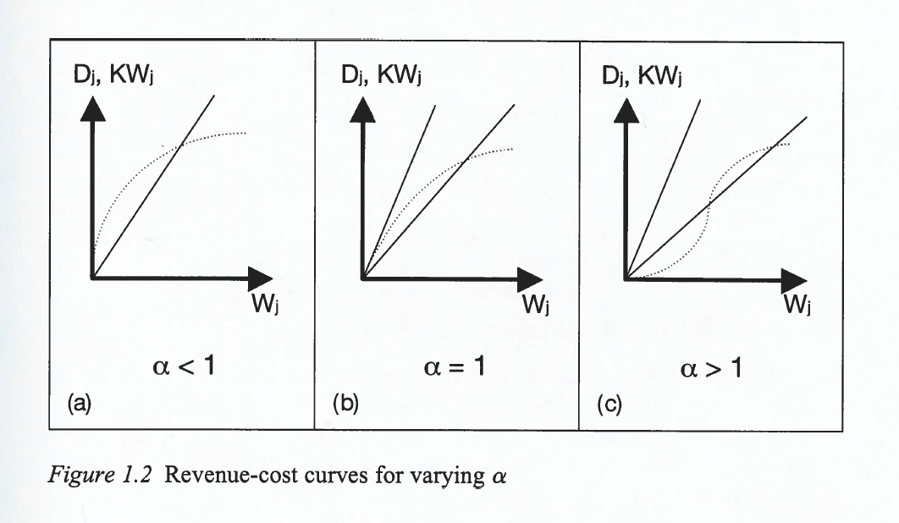
5.4. Dynamics: beyond PoC

Slide 24
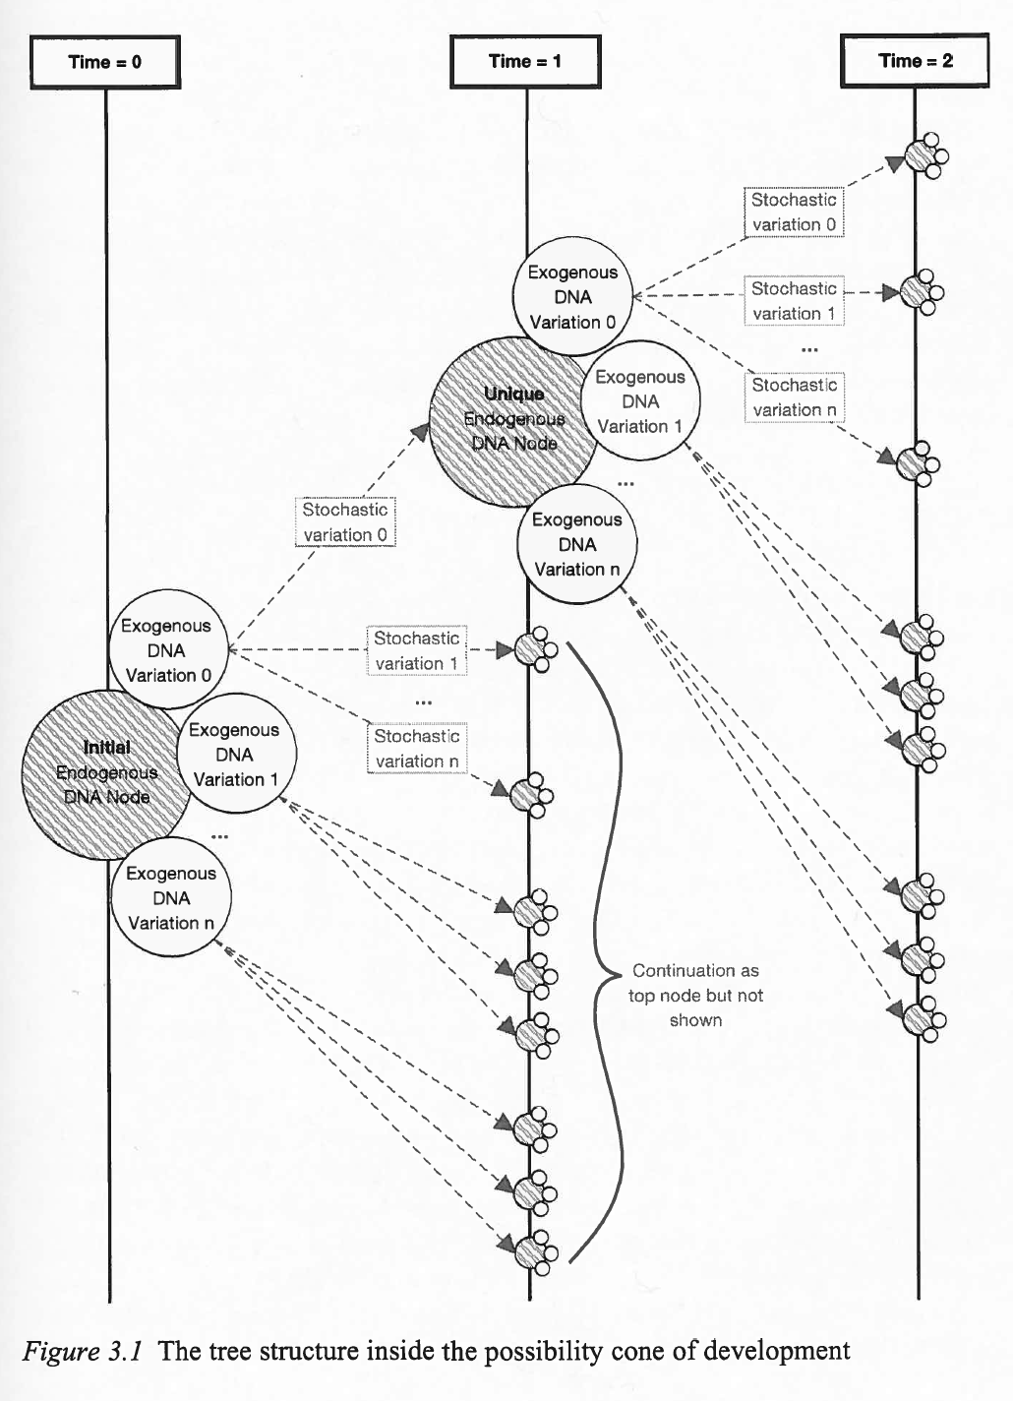
Possibility cones Dearden and Wilson (2015)

Slide 25
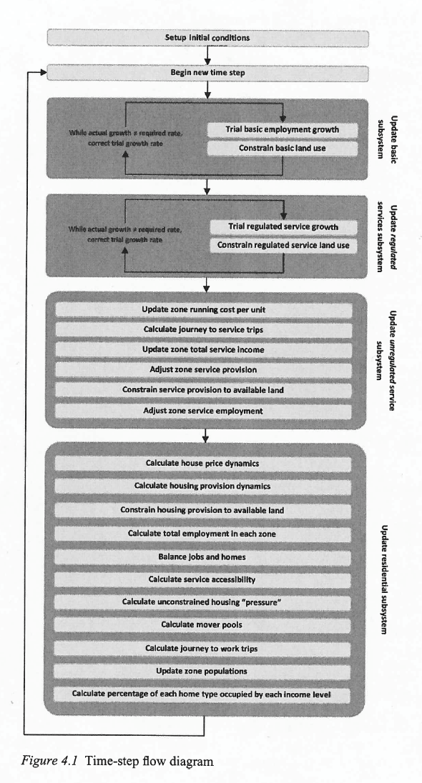
Full dynamics in a a Lowry model Dearden and Wilson (2015)

Slide 26
5.5. A new era for planning: an analytics-driven intelligence system
Static data
(geometry, census etc.)
Information
System
Input: outputs from different datasets
Scenarios and plans
Outputs: platform data base; some reports
The science: models and analysis:
outputs and planning indicators
Dynamic real time data
Console
Planning Knowledge
(densities, health, education, heritage etc. )
Scenarios and Plans
Actions
Reports from C.E.
Monitoring; ‘red lights’
Roumpani, Hudson-Smith and Wilson, 2014

Slide 27
Can this ‘new era’ be achieved?
resources, funding
skills, numbers
ambition
then, having seen what is possible, do it!

Slide 28
For young researchers …….
be aware of the field of possibilities
be ambitious
which means PoC for something new, not ‘more of the same’
if you are following fashion
be aware of what has gone before, and possibly build on it
‘against oblivion’
think about the challenges that take you ahead of the fashion

Slide 29
Getting ahead of the fashion: laying bets
the comprehensive model – with additions
health, education
full dynamics
transforming planning
underpin with a full searchable information system, taking advantage of new data sources (and the basis for real-time model calibration)
integrate both statistics and the maths with machine learning
recent example: s.i. model calibration from structure
(comes from finding new collaborators)

Slide 30
Annex. Steps to a comprehensive model in the new era
Review existing land uses and values; identify land that is available for future use or conversion
Review current infrastructure, supporting people and economies
Review employment (and the future of work)
Review the population distribution ( by age, gender, skills, income, household structure, residence, work, services; accessibilities – start to build indicators
Review service and utilities provision
Build an index of the attractiveness of places – indicators again

Slide 31
Review spatial interactions, accessibilities – imbalances – unemployment, homelessness; pressures for change
Present, visualise, a full set of indicators
Proceed to scenario development: identify land that can accommodate growth – giving priority to export-led industry; specify land availability for new housing
Assign the new employees to places of residence – note, through the model, competing with existing ‘movers’; the ‘attractiveness of residential places’, and prices, will begin a process of continuous adjustment

Slide 32
Calculate the demand for services for the new population distribution (age, income etc); retail can be predicted; health and education facilities e.g. may have to be specified
Analyse the dynamics
Iterate from step 10 (new employees from new services etc)
Use unit costs of infrastructure – housing, road, rail, school places etc as the basis for a cost-benefit analysis of this scenario
Re-iterate from Step 9 with a new scenario, informed by the analytics of preceding ones

Slide 33
References-1: books
Knowledge power (Routledge, 2010),
The science of cities and regions (Springer, 2012)
Urban modelling (5 vols, edited, Routledge, 2013)
Explorations in urban and regional dynamics (with Joel Dearden, Routledge, 2015)
Global dynamics (edited, John Wiley, 2016)
Geo-mathematical modelling (edited, John Wiley, 2016)
Collaborative approach to trade: enhancing connectivity in sea- and land-locked countries (with Francesca Medda et al, Springer, 2017)

Slide 34
References-2: papers
Wilson, A. G. and Dearden, J., 2011. Tracking the evolution of regional DNA: the case of Chicago. In: M. Clarke and J.C.H. Stillwell, eds. Understanding population trends and processes. Berlin: Springer, Chp. 1-, pp. 209-222.
Bevan, A. and Wilson, A. G., 2013. Models of settlement hierarchy based on partial evidence. Journal of Archaeological Science, 40 (5), pp. 2415-2427. http://dx.doi.org/10.1016/j.jas.2012.12.025
Davies, T., Fry, H., Wilson, A., Palmisano, A., Altaweel, M. and Radner, K. 2014. Application of an Entropy Maximizing and Dynamics Model for Understanding Settlement Structure: The Khabur Triangle in the Middle Bronze and Iron Ages. Journal of Archaeological Science doi:10.1016/j.jas.2013.12.014.
Baudains, P; Zamazalová, S; Altaweel, M; Wilson, A. G., 2015. Modeling Strategic Decisions in the Formation of the Early Neo-Assyrian Empire. Cliodynamics: The Journal of Quantitative History and Cultural Evolution, 6(1), 1-23.
Baudains, P., Fry, H. M. , Davies, T. P., Wilson, A. G. and Bishop, S. R. A dynamic spatial model of conflict escalation. European Journal of Applied Mathematics, 27(3), 530-553.
Dearden, J. and Wilson, A.G., 2011. A framework for exploring urban retail discontinuities. Geographical Analysis, 43 (2), pp. 172-187

Slide 35
References-3: Foresight – Fututre of Cities Reports ………..
Overview of the Evidence:
https://www.gov.uk/government/uploads/system/uploads/attachment_data/file/520963/GS-16-6-future-of-cities-an-overview-of-the-evidence.pdf
Science of Cities: https://www.gov.uk/government/uploads/system/uploads/attachment_data/file/516407/gs-16-6-future-cities-science-of-cities.pdf
Foresight for Cities: https://www.gov.uk/government/uploads/system/uploads/attachment_data/file/516443/gs-16-5-future-cities-foresight-for-cities.pdf
Graduate Mobility: https://www.gov.uk/government/uploads/system/uploads/attachment_data/file/510421/gs-16-4-future-of-cities-graduate-mobility.pdf

